Slide 1
Activity Monitor Data Wrangling
BIOS 6644 Final Project - Andrew Hill

Slide 2
Data Background
What/Why?
Activity Data is data from a wearable device with an accelerometer (like a Fitbit or similar device).
Accelerometer data can be used as an ““objective”” measure of a person’s activity.
Can we group/cluster patients based on their activity?
i.e. Find common patterns that a group of patients share?
Are they clinically/biologically relevant?
Issues?
Data is inherently noisy.
Data contains missing values.
Patients will take off monitor to sleep, swim, etc.
Data is in “long” format.
Each row contains a single measurement.
Notes:
Activity data is time series data that can be collected using any device with an accelerometer, like a Fitbit or Apple Watch. This kind of data is interesting to researchers, since it can be gathered as a secondary piece of data during a study, and used for analysis later.
For example, one of the projects I work enrolled patients at COPD patients at National Jewish to wear an activity monitor for a week. Each patient’s activity was recorded, along with a timestamped records of their inhaler usage and any “severe” COPD related events they experienced during the week.
Activity data can be issue-prone though, since the data is very noisy due to the low frequency of data recording (records cumulative activity once per minute). There can also be issues when patients don’t wear the device for long periods of time, leaving “gaps” in the time series.
For my research, we want to cluster this data to find groups of patients which have similar activity patterns. We need the data to be in a specific format, but the majority of this type of activity data is recorded in a “long” format, where each row contains a single measurement. This means we have to pivot the data before we can use it as input to any of the algorithms.

Slide 3
Data Wrangle Motivation and Process
Motivation
Doing unsupervised learning on data, so need to try different normalization methods/combinations.
Prior to this class, I would wrangle the data into a normalized format, then output to a new CSV file.
Wanted a way to mix/match normalization methods quickly without re-writing normalization code each time.
Normalization Process
Convert “long” format to a “wide” format (pivot).
Drop any subjects with unusable data.
Normalize remaining data (Z-transform, Min/Max, etc) so that it plays nice with clustering algorithms.
Send data to clustering algorithm.
Notes:
We are trying to do unsupervised learning with this data, which means that we need to try many different normalization methods, or combinations.
For example, we can compare overall levels of activity between patients (to find which patients are the most/least active), or we may be interested in patients who exhibit similar trends, regardless of overall activity level (i.e. some patients are more active on weekends, at night, etc).
Most of the clustering methods are also sensitive to data scale (range of the data), so we need to normalize the data to fall into a more reasonable range.
My standard process for normalizing data is on the right side of the slide:
Regardless of what normalization methods we want to use, we always have to pivot the data first so that the format is correct for the clustering algorithms.
Next, we need to drop any subjects that have “unusable” data. This might mean dropping subjects who don’t wear their device often enough, have too many spurious measurments, etc. In the NHANES dataset I used for this demo, there are a group of patients who have a constant measuremnet value for the entire week-long study. This is obviously not correct, so we can drop these subjects.
Finally, we can apply any of the scaling normalization methods, like Z-tranform, to make the values of our data more reasonable.

Slide 4
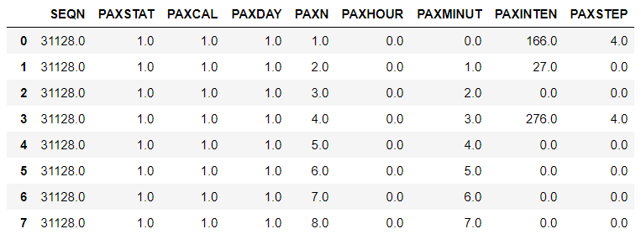
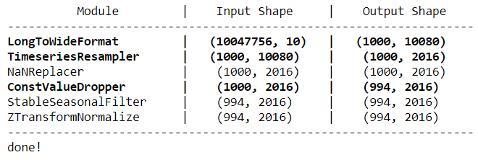
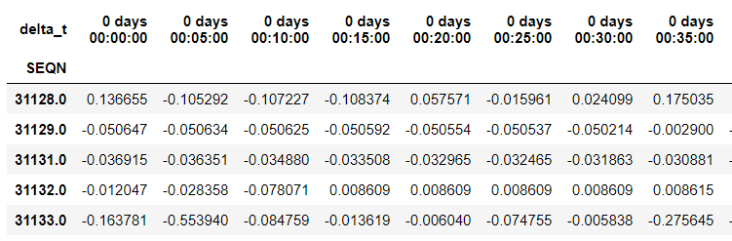
Demonstration
Raw Data
Patient ID
Activity Intensity
Normalization Output
Normalized Data
Columns are time intervals.
One Patient ID per row
Notes:
This slide shows an example of the data before and after normalization.
In the raw data, each measurement is recorded as a row in the DataFrame.
My normalization code runs a set of normalization procedures that I specify (most of them are just wrappers around existing Pandas functions), and prints out a list of the normalization procedures that were applied, as well as the shape/dimensions of the data before and after each normalization step. Steps highlighted in bold are where the data dimensions are modified during the normalization.
In the output DataFrame, each patient has all measurements in a single row, with the columns representing the measurement at each timestep. This is a (num_patients x num_measurements) matrix, which is the standard format that most of the clustering algorithms expect for input.

